Slide 1
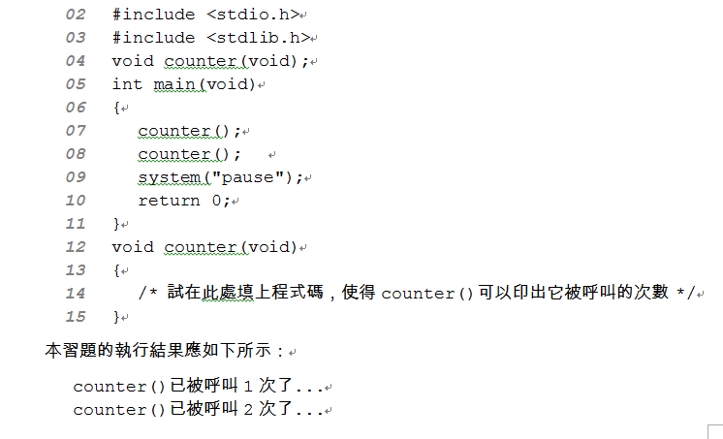
A practice (請自訂輸出)
Complete the program:
Use global variables
Use static variables

Slide 2
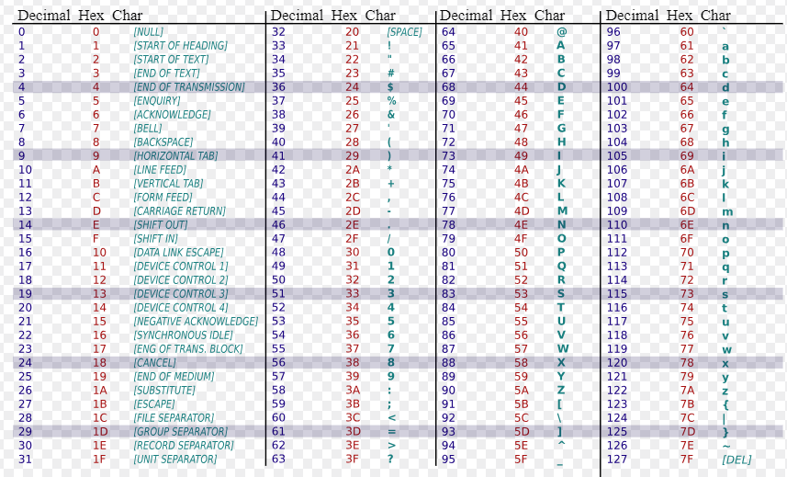
1.cpp：列印ASCII 表格:
  print_ascii(int start, int end, int count) 從字元編號start印到end
  每count個字元印完，就請換行
  main(): print_asci(33, 126, 5); print_asci(65,122, 10);

Slide 3
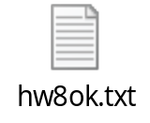
2.cpp
Find the n^{th} prime number
Write a function: get_nth_prime()
  Input: One integer parameter
  Output: Return the n^{th} prime number
  Note: the first prime is 2, the second prime is 3…
  用來找出第n個質數 (第一個質數為2, 第二個質數為3… )
  P.S In this function, you can reuse the function is_prime() written last week. Let the program be more structured (modularity)
In main program, by using this function:
  Find and print the 100th prime number
  Find and print the 700th prime number

